Slide 1
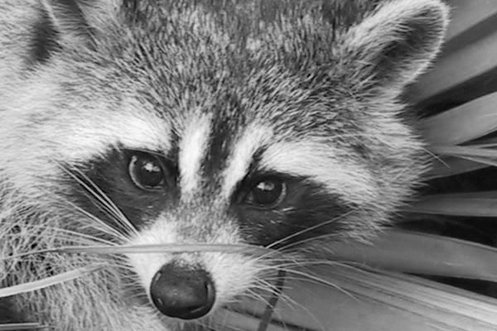
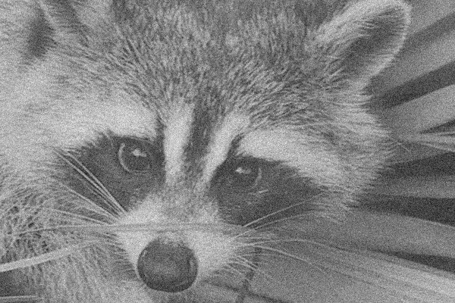

Total Variation Denoising
By Basile Hurat

Slide 2
Outline
Total Variation Denoising
What it is
Problems
Steepest Descent method
Problems and solutions
Code
Preliminary Results
Primal Dual method
How it works
Code
Conclusions
Results
Multiple Images

Slide 3
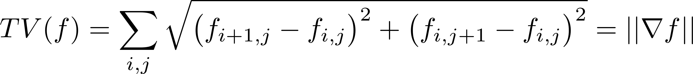

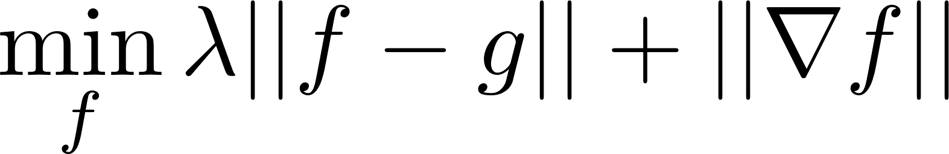
What is Total Variation Denoising?
Total Variation measures, as the name suggests the total variation of an image from pixel to pixel.
Clearly, adding noise to an image likely increases
As such, the idea behind Total Variation Denoising is minimizing that while keeping the new image close to the old one.

Slide 4


Total Variation Denoising: Problems
Given a noisy image g, TV denoising is
Not Differentiable
Discrete
Often large problems (Ours is 400x600 pixels or 240,000 variables!)
We’ll look at two different approaches to TV Denoising:
Rudin-Osher-Fatemi Denoising:
TV-$L_{1}$:
Lets start with a simple steepest descent

Slide 5
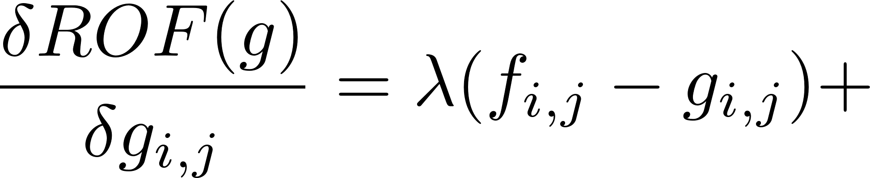
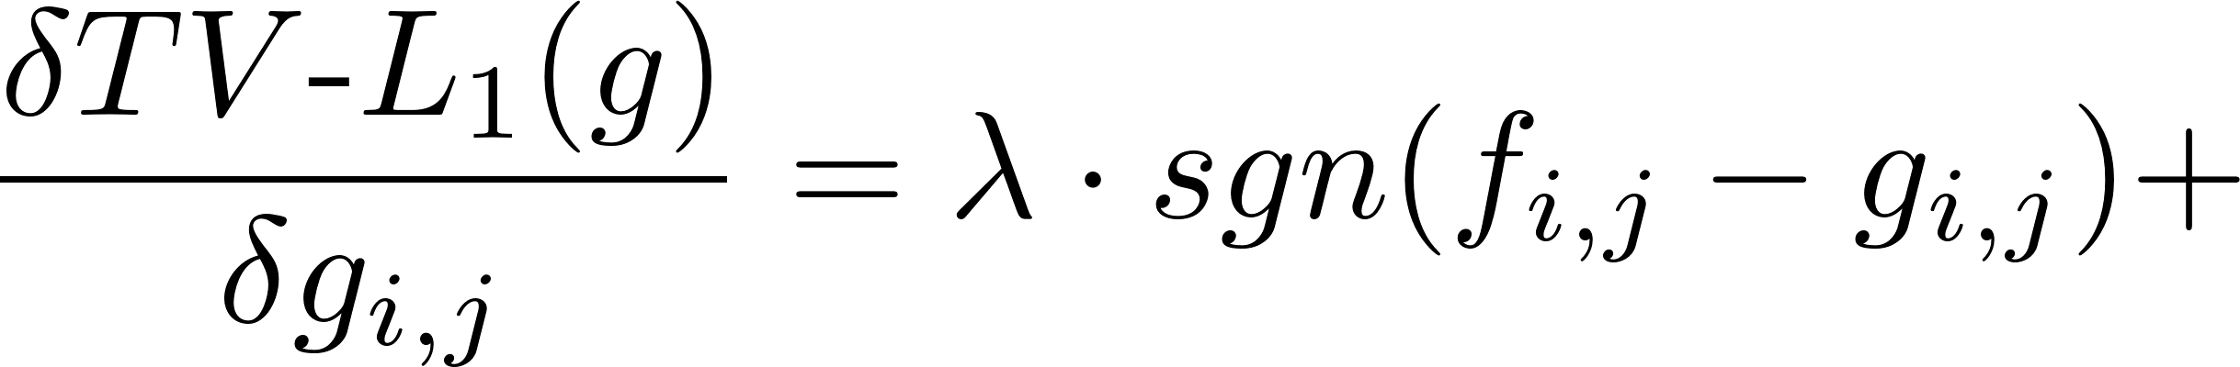
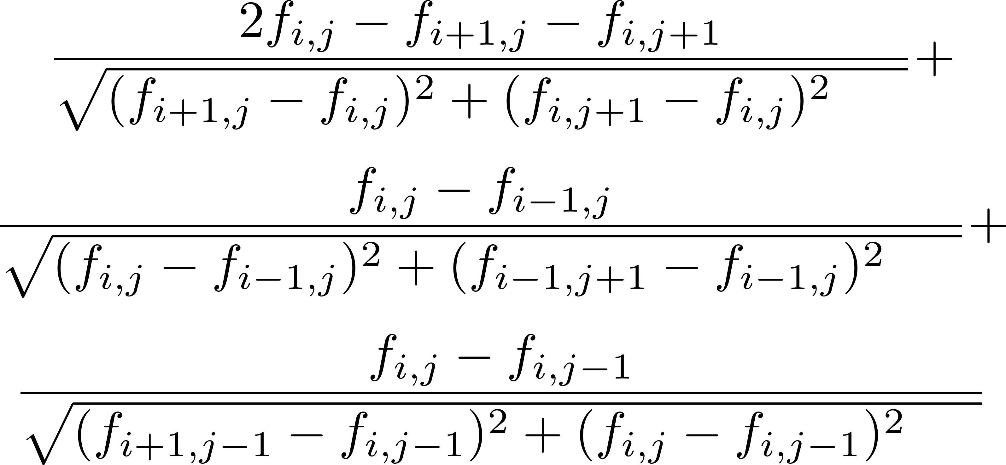



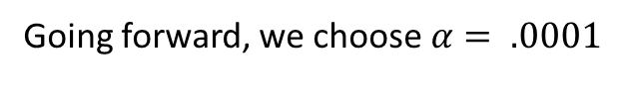



Steepest Descent: Gradients
Let’s start by fixing the differentiability issue.
$$+α$$
$$+α$$
$$+α$$
$$+α$$
$$+α$$
$$+α$$
Going forward, we choose $α= .0001$

Slide 6
Other Issues: Discreteness and Size
Given that our gradient is inexact and discrete, our algorithm will never reach zero.
On top of that, the size of the problem tied with steepest descent would take ages.
Luckily, the problems solve each other as the algorithm stops minimizing pretty quickly. So that’s nice!
Besides that, we can use the functions and gradients defined on the previous slide in a straightforward steepest descent algorithm with backtracking.

Slide 7
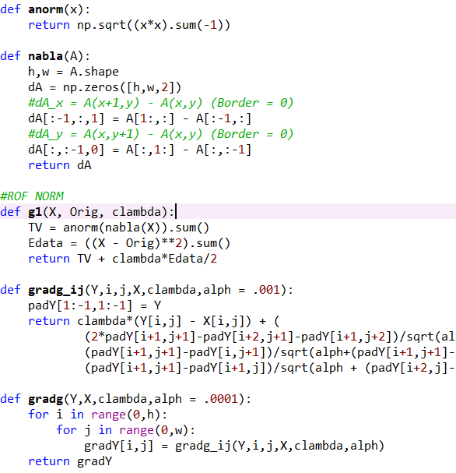
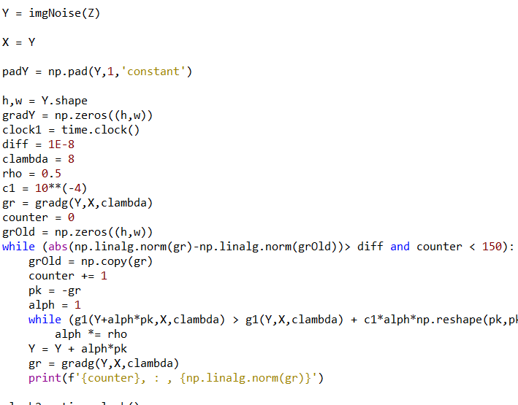
Steepest Descent: ROF Code

Slide 8

Results – ROF
We work on our first image, a racoon. After 150 iterations, and waiting 4801 seconds (80 minutes!) we get decent results! It has a total ROF energy of 1473.

Slide 9
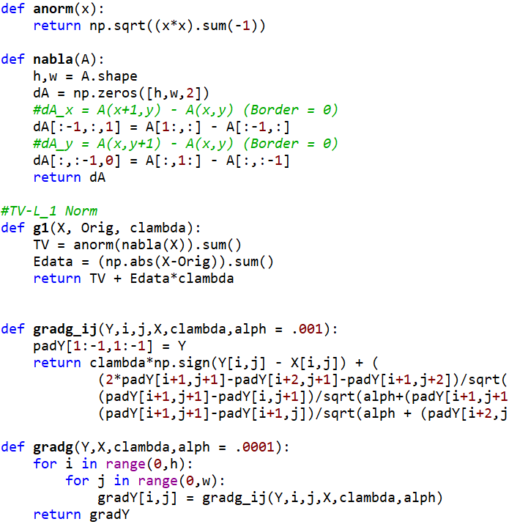
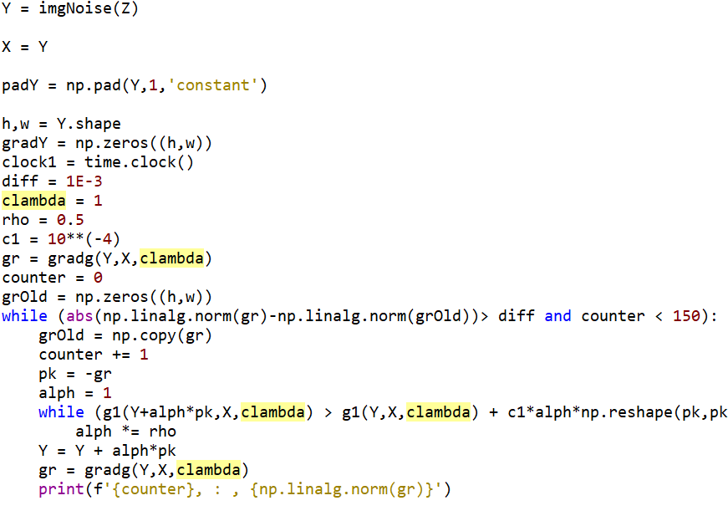
Steepest Descent: TVL1 Code

Slide 10

Results TV-L1
The TV-L1 method worked a little worse on paper, taking 5249.2 seconds (87.5 minutes!) and having a TV-L1 Energy of 25687 (though TV-L1 often results to a higher energy).
However, looking strictly at the image, we see a very similar result, with perhaps a bit more texture for TV-L1

Slide 11
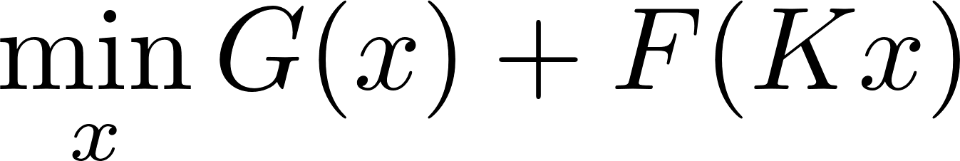
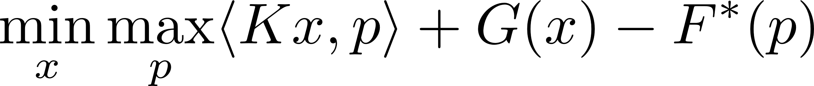
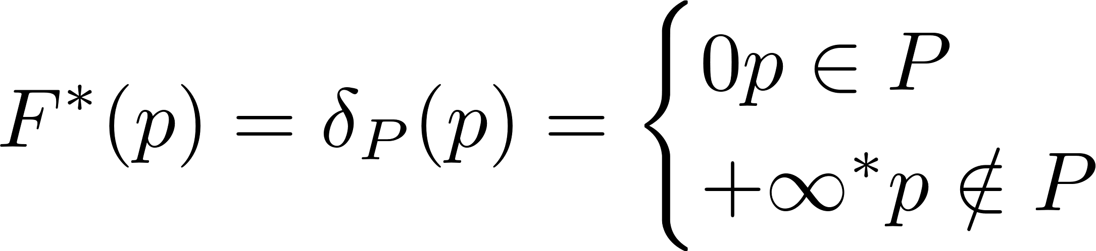
Primal Dual Method
Given how slow steepest descent is, and the plethora of problems it has, another method is greatly desired.
Enter the Primal-Dual method! This is a method that uses both a dual formulation and proximity operators to solve our problem.
We define the dual of the problem first:
where
*: Since our image is scaled, we may set this simply to 1 in our algorithm

Slide 12
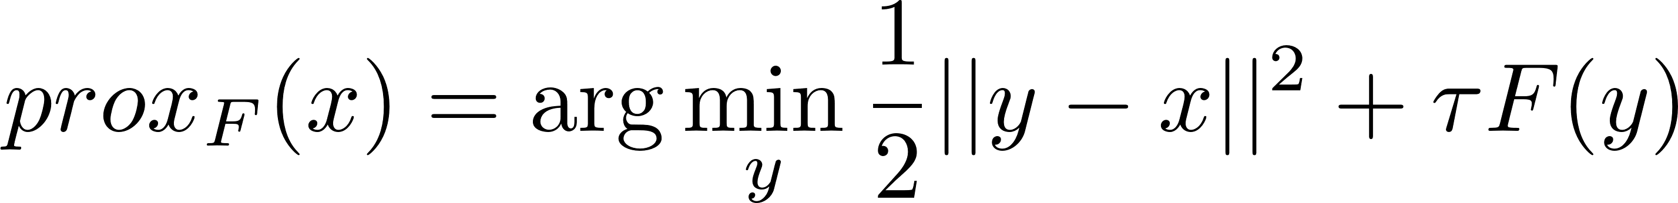
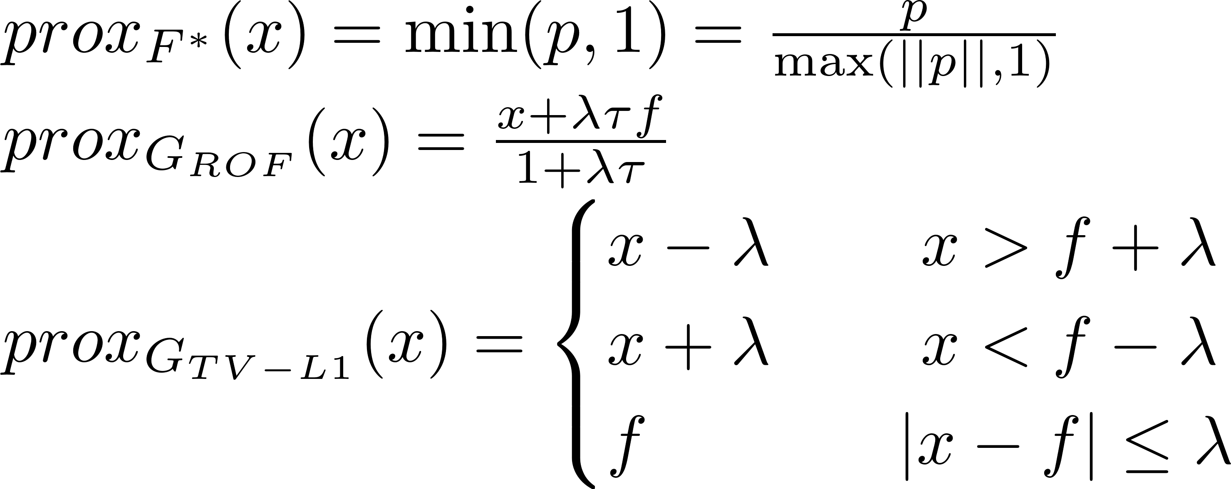
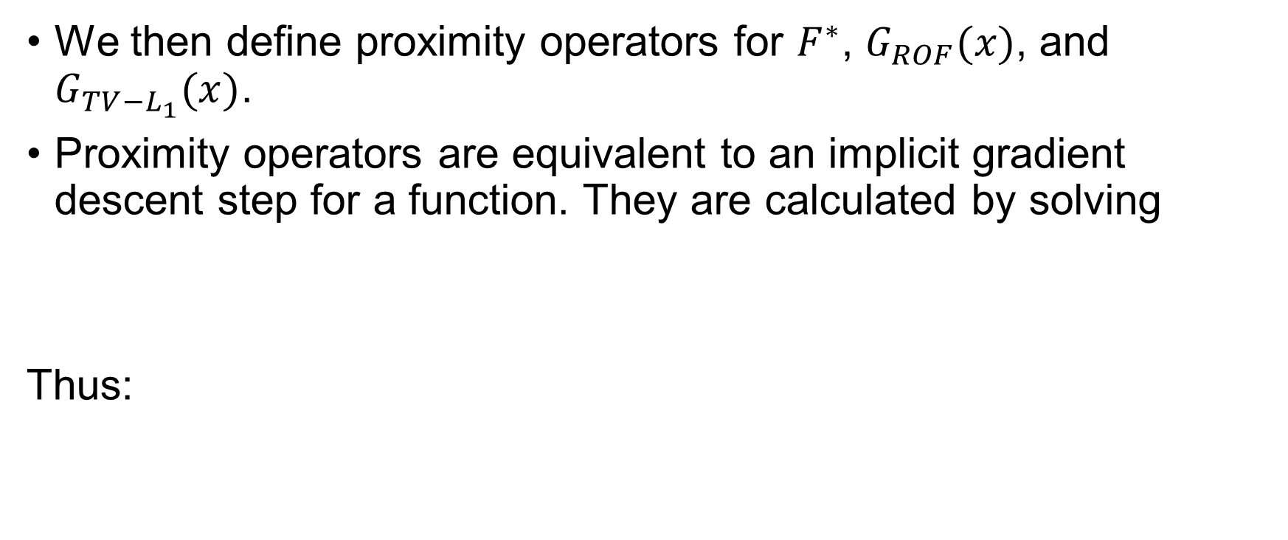
Primal Dual: Proximity Operators
We then define proximity operators for $F^{∗}$, $G_{ROF}(x)$, and $G_{TV−L_{1}}(x)$.
Proximity operators are equivalent to an implicit gradient descent step for a function. They are calculated by solving
Thus:

Slide 13
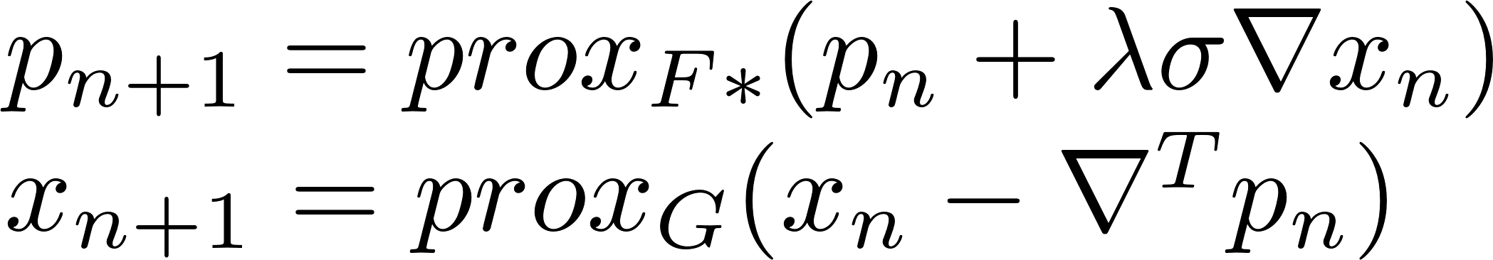
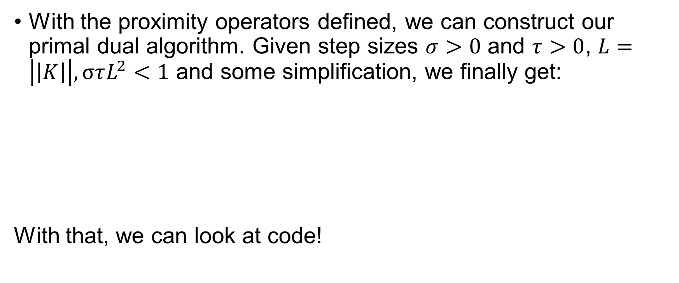
Primal Dual: Algorithm
With the proximity operators defined, we can construct our primal dual algorithm. Given step sizes $σ>0$ and $τ>0$, $L=\left|\left|K\right|\right|, στL^{2}<1$ and some simplification, we finally get:
With that, we can look at code!

Slide 14
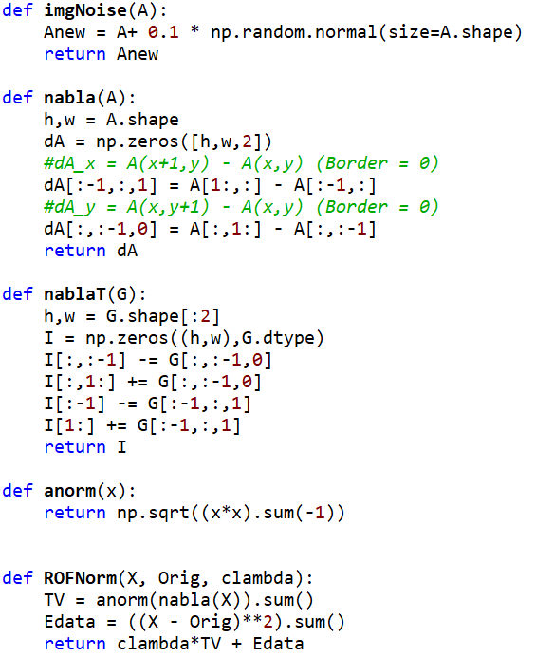
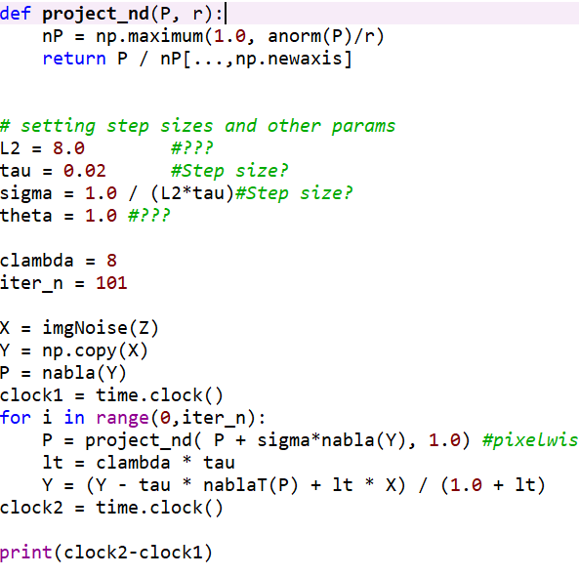
Primal Dual: ROF Code

Slide 15
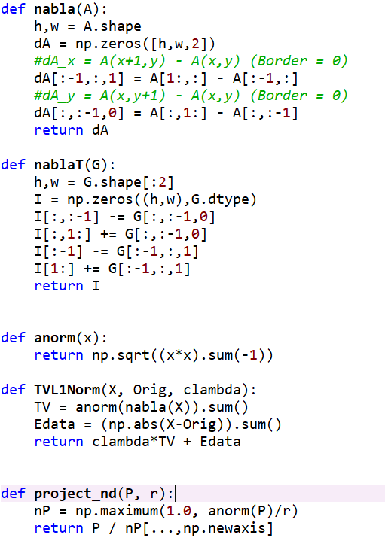
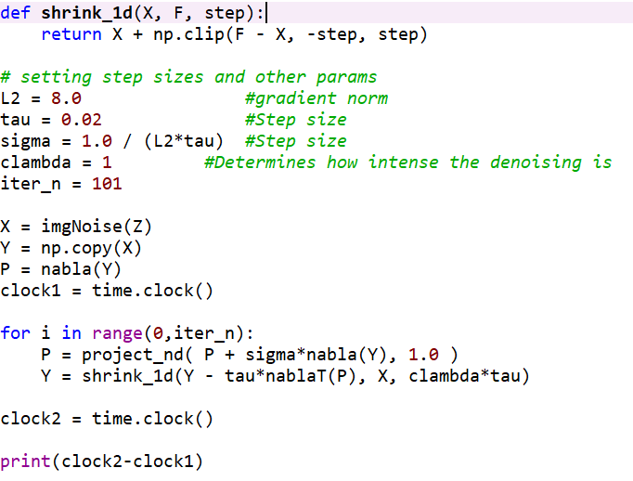
Primal Dual: TV-L1 Code

Slide 16
Results!
Original
Racoon
Textured image
Noisy
ROF Energy: 26,663
TV-L1 Energy: 26,663

Slide 17
Results!
Original
Racoon
Textured image
ROF Steepest Descent
Gradient Norm: 2.577
Time taken: 4801 sec
ROF Energy: 14743

Slide 18
Results!
Original
Racoon
Textured image
ROF Primal Dual
Time taken: 5.6869 sec
ROF Energy: 14036

Slide 19
Results!
Original
Racoon
Textured image
TV-L1 Steepest Descent
Gradient Norm: 170.8
Time taken: 5249.2 sec
TV-L1 Energy: 25687

Slide 20
Results!
Original
Racoon
Textured image
TV-L1 Primal Dual
Time taken: 6.2443 sec
TV-L1 Energy: 25219

Slide 21
Conclusions
With the demand for higher resolution images today, it is necessary to have an algorithm that scales well.
Further problems could be: Parallelizing steepest descent, finding ideal lambda, seeing effects on weird images (dithered images, different kinds of noise, etc.)
Comparison
Steepest Descent
Primal Dual
Partially parallelizable
Simple to do, reusable
Much much faster
Slightly better results

Slide 22
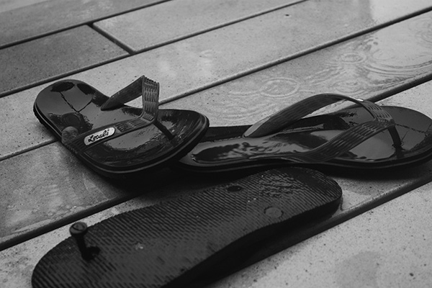
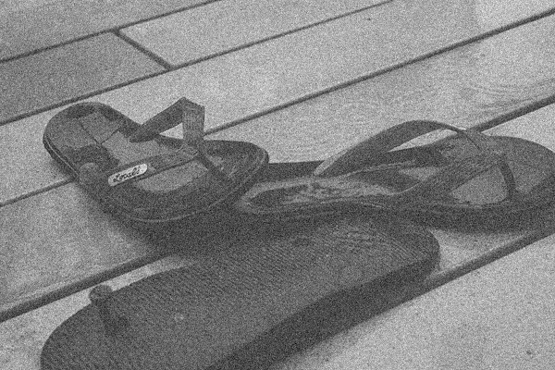
Results!
Original
Flipflops
Simple, High
contrast
Noisy

Slide 23

Results!
Original
Flipflops
Simple, High
contrast
ROF Steepest Descent

Slide 24

Results!
Original
Flipflops
Simple, High
contrast
ROF Primal
Dual

Slide 25

Results!
Original
Flipflops
Simple, High
contrast
TV-L1 Steepest Descent

Slide 26

Results!
Original
Flipflops
Simple, High
contrast
TV-L1 Primal
Dual

Slide 27


Results!
Original
Basile
A face!
Noisy

Slide 28

Results!
Original
Flipflops
Simple, High
contrast
ROF
Steepest
Descent

Slide 29

Results!
Original
Flipflops
Simple, High
contrast
ROF
Primal
Dual

Slide 30

Results!
Original
Flipflops
Simple, High
contrast
TV-L1
Steepest
Descent

Slide 31

Results!
Original
Flipflops
Simple, High
contrast
TV-L1
Primal
Dual

Slide 32
Bibliography
Chambolle, Antonin. “An Algorithm for Total Variation Minimization and Applications”. 2004
Mordvinstev, Alexander. “ROF and TV-L1 denoising with Primal-Dual algorithm”. http://www.webcitation.org/6rEjLnF1F. 2013
Beck, Amir. “First-Order Methods in Optimization”. Ch 6: The Proximal Operators. Society For Industrial and Applied Mathematics. 2017.

